Slide 1
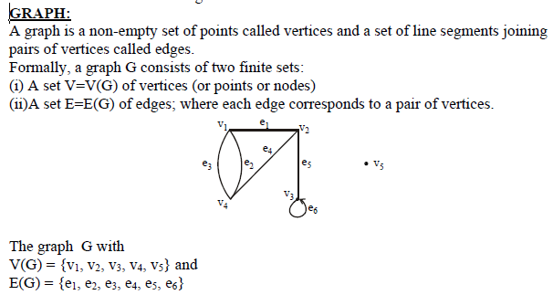
Lecture# 20 Introduction to Graphs

Slide 2
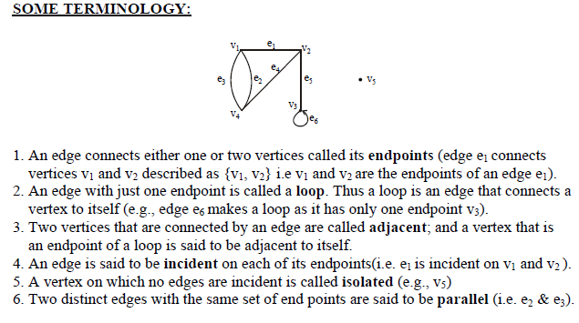

Slide 3
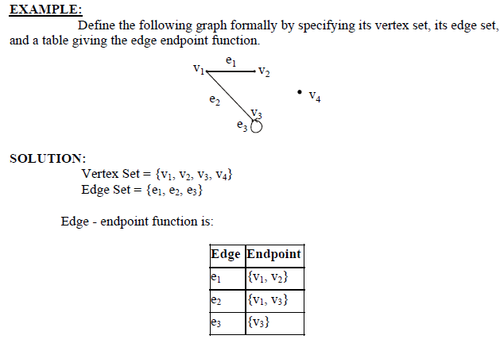

Slide 4
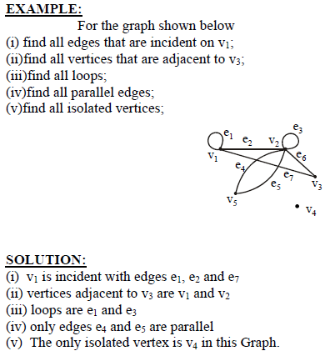

Slide 5
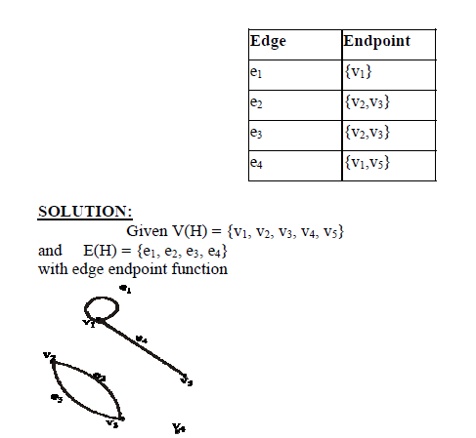
DRAWING PICTURE FOR A GRAPH:
Draw picture of Graph H having vertex set {v1, v2, v3, v4, v5} and edge set {e1, e2, e3, e4} with edge endpoint function

Slide 6
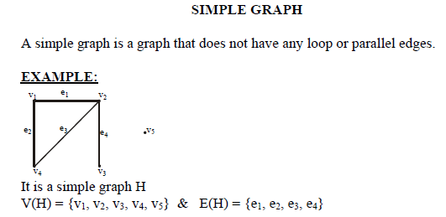

Slide 7
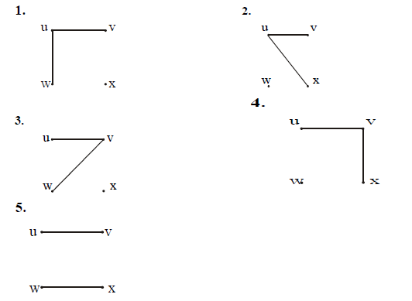
EXERCISE:
Draw all simple graphs with the four vertices {u, v, w, x} and two edges,
one of which is {u, v}.
SOLUTION:
There are C(4,2) = 6 ways of choosing two vertices from 4 vertices. These
edges may be listed as:
{u,v},{u,w},{u,x},{v,w}, {v,x},{w,x}
One edge of the graph is specified to be {u,v}, so any of the remaining five from this list may be chosen to be the second edge. This required graphs are:

Slide 8
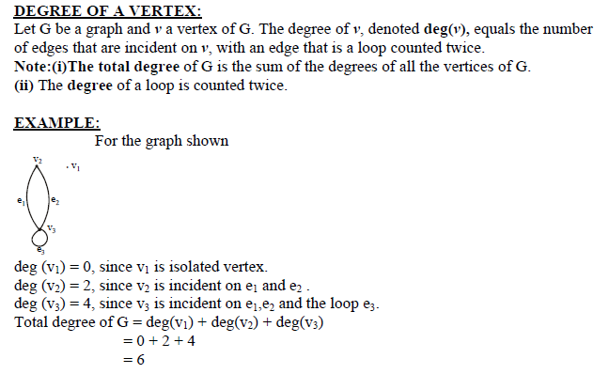

Slide 9

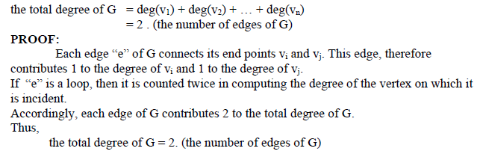
REMARK:
The total degree of G, which is 6, equals twice the number of edges of G, which is 3
COROLLARY:
The total degree of G is an even number

Slide 10
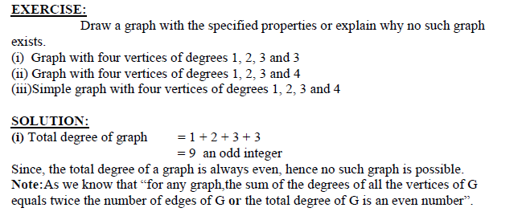

Slide 11
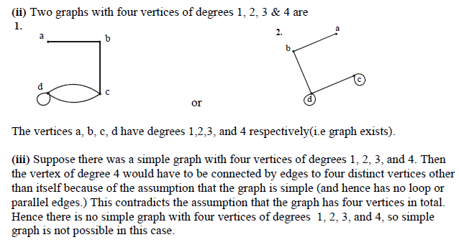

Slide 12
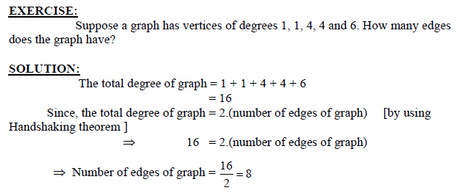

Slide 13
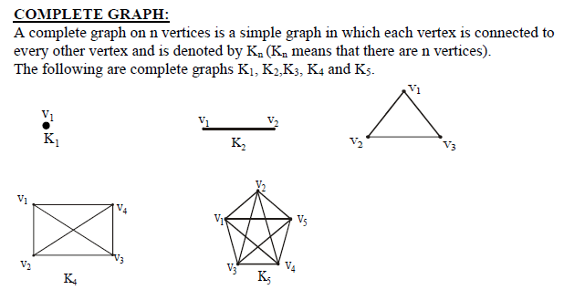

Slide 14
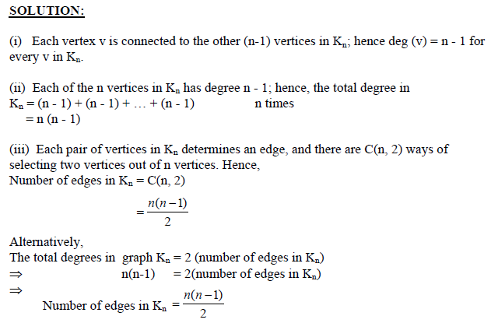
EXERCISE:
For the complete graph Kn, find
(i) the degree of each vertex
(ii)the total degrees
(iii)the number of edges

Slide 15
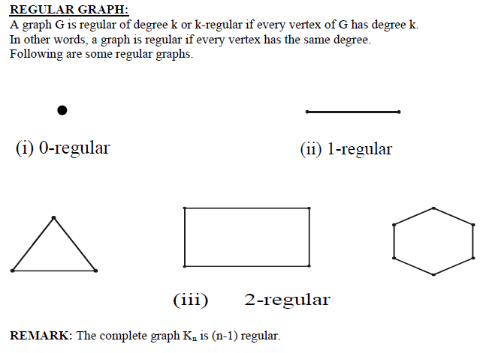

Slide 16
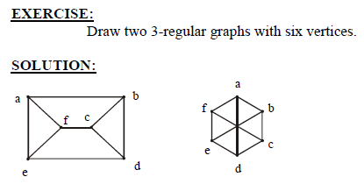

Slide 17
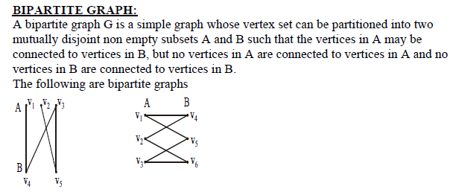

Slide 18
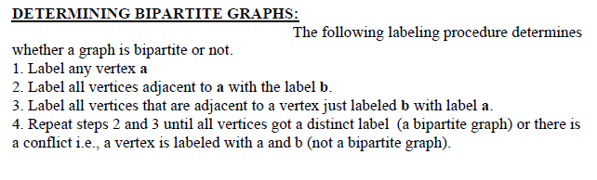

Slide 19
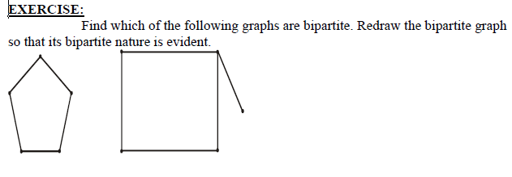

Slide 20
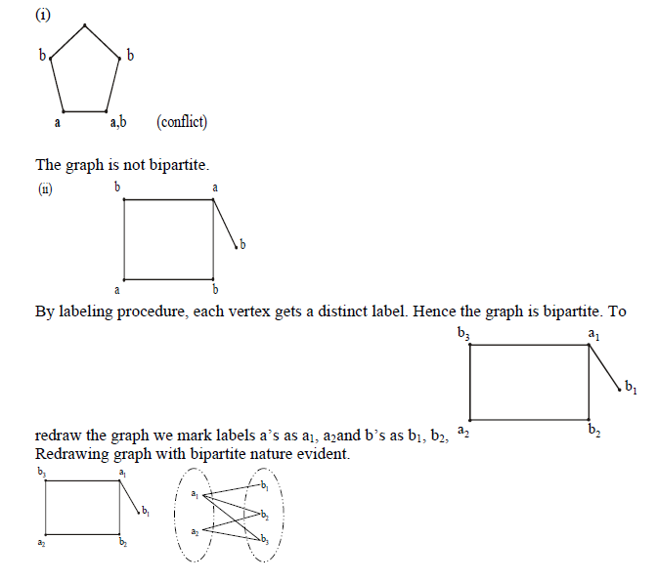

Slide 21
